Slide 1
Bulk Payments with 3PPI
Presented by Elijah Okello

Slide 2


Slide 3
Alfajiri
Participated in the DFS Lab PISP Bootcamp
Designed and built a bulk payments solution

Slide 4
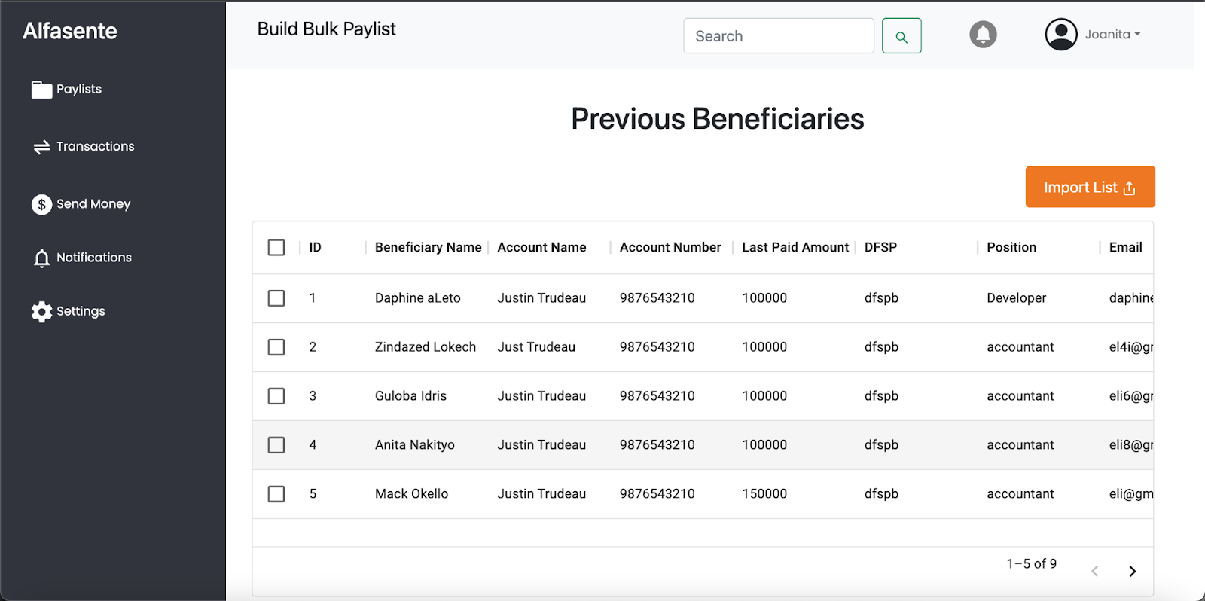

Slide 5
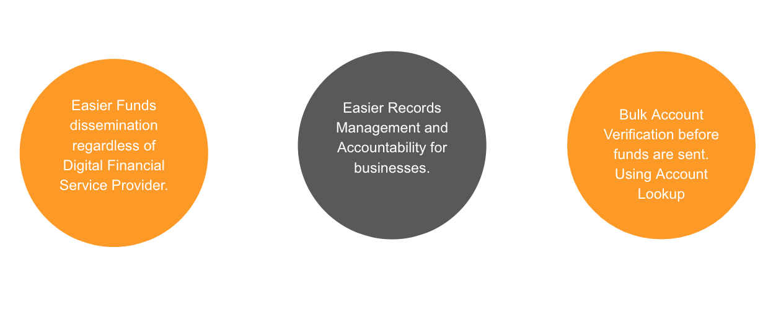
Why Alfasente ?

Slide 6
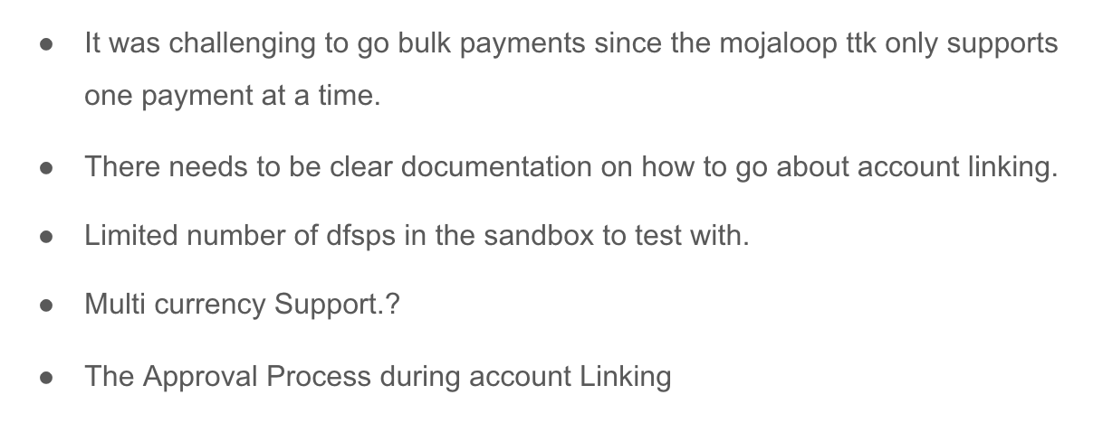
Experience during Implementation

Slide 7
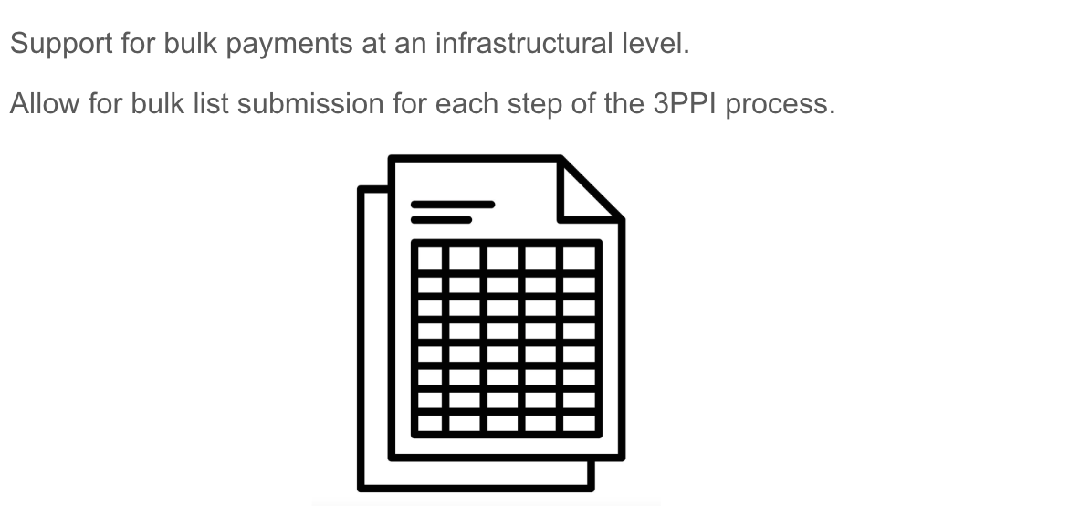
Recommendations

Slide 8
elijahokello@alfajiri.co

